Slide 1
Principles of Drug Discovery
Lecture 4: Protein-Ligand Binding
Notes:
5/11/17
1
1

Slide 2
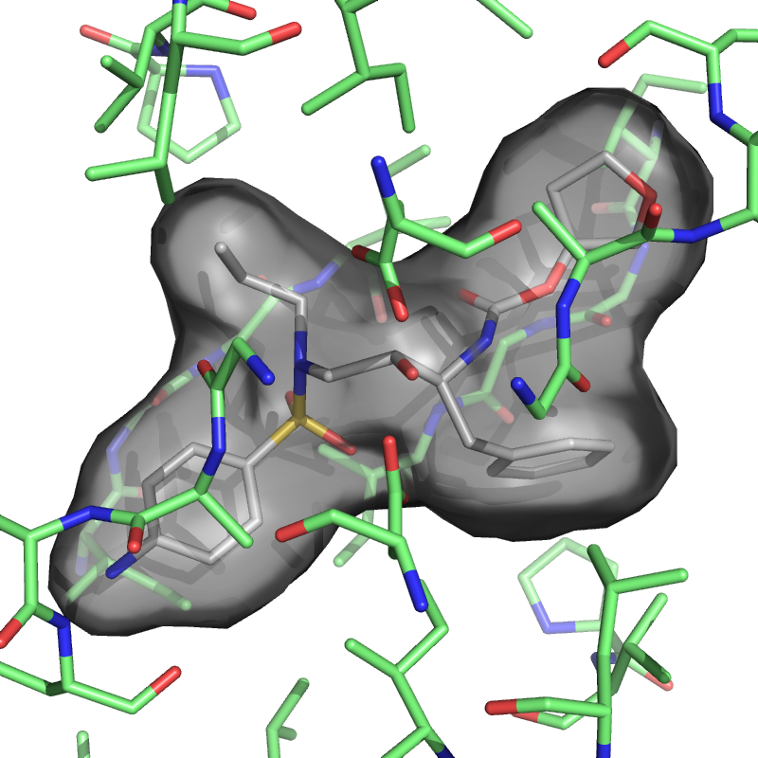
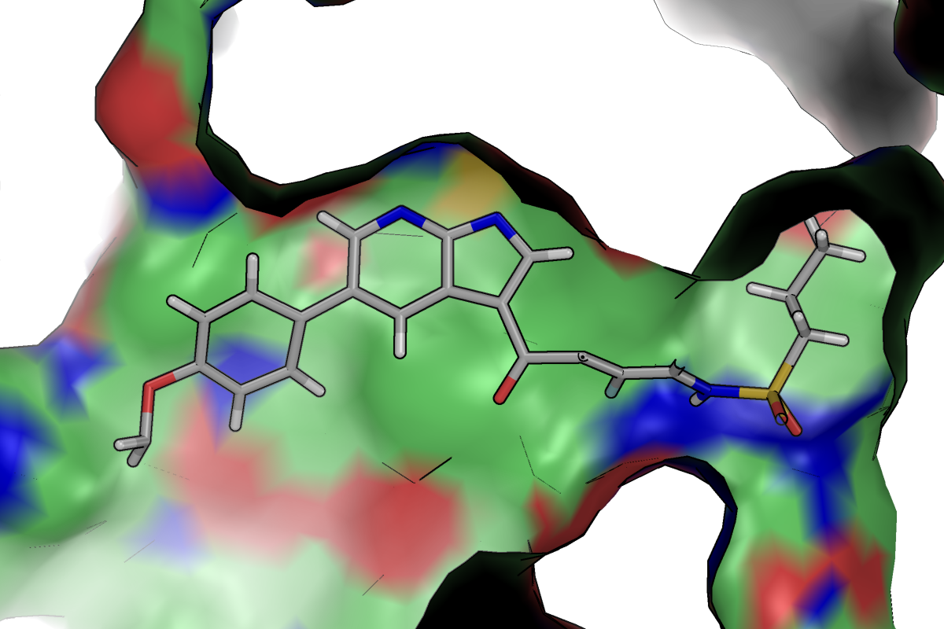
Protein bind to ligands usually via non-covalent interactions (no bonds are broken or formed)
Inhibitor binding to the kinase B-Raf
Inhibitor binding to HIV-1 Protease
What are the driving forces which govern non-covalent molecular recognition?

Slide 3
Intermolecular Interactions

Slide 4
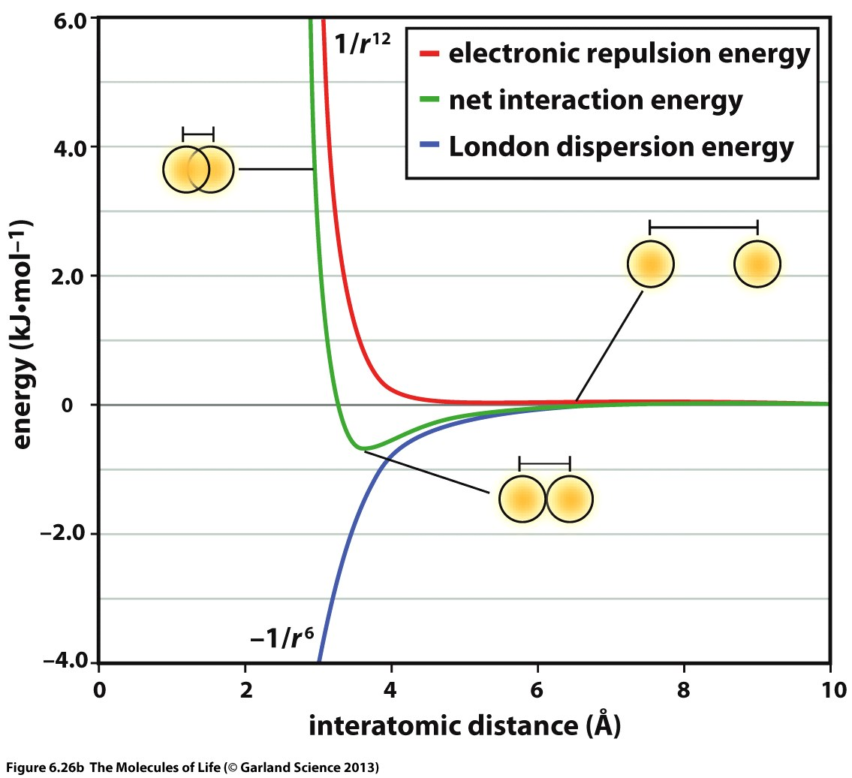
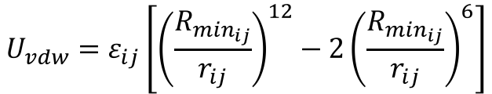
$$U_{vdw}=ε_{ij}\left[{\left(\frac{R_{\min_{ij}}}{r_{ij}}\right)}^{12}−2{\left(\frac{R_{\min_{ij}}}{r_{ij}}\right)}^{6}\right]$$
Strong repulsion at short distances
Short ranged (decays with 1/r⁶)
Well-depth depends on polarizability (heavier atoms like sulfur or bromine form stronger van-der-Waals interactions)

Slide 5
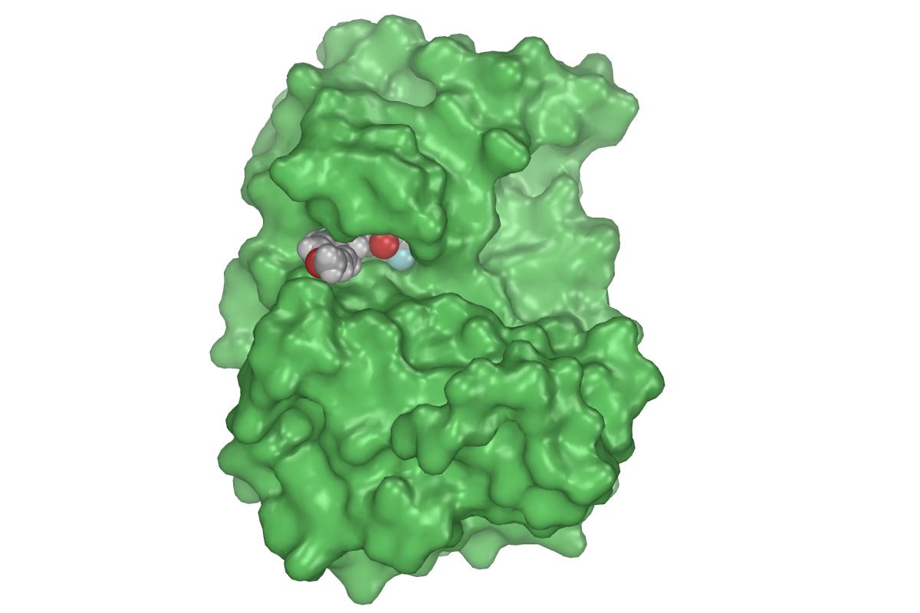
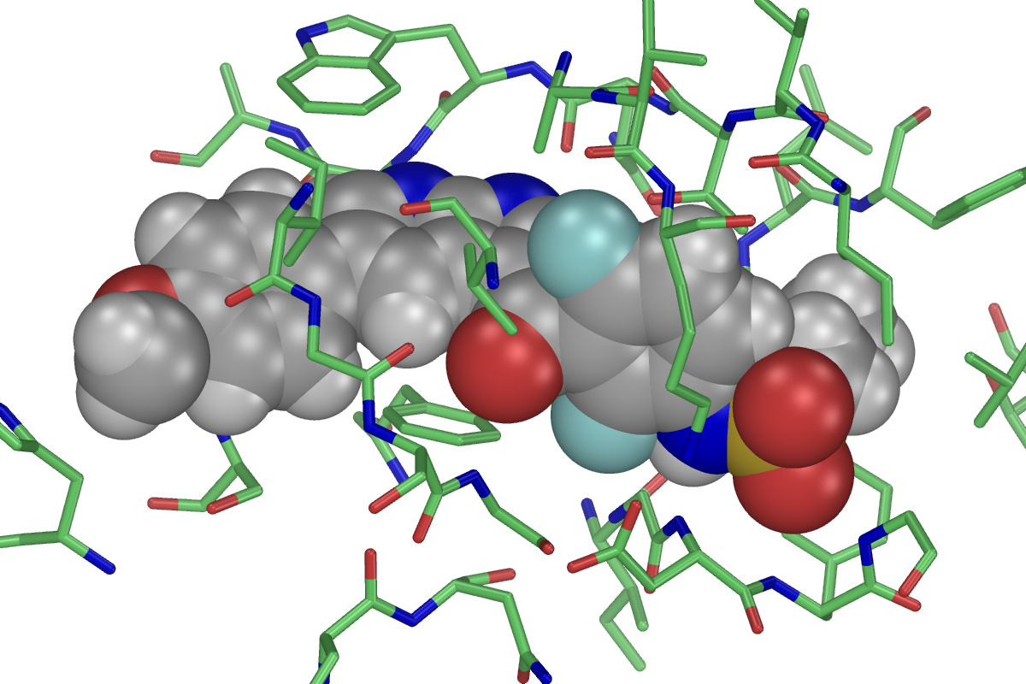
Van der Waals radii are often used o visualize surfaces and binding sites
Ligand atoms shows as VdW spheres
Protein surface computed based on VdW radii

Slide 6
Consequences for Ligand Optimization
Ligands should complement the shape of the binding site
Introducing groups which are too large will result in a sharp drop in affinity

Slide 7
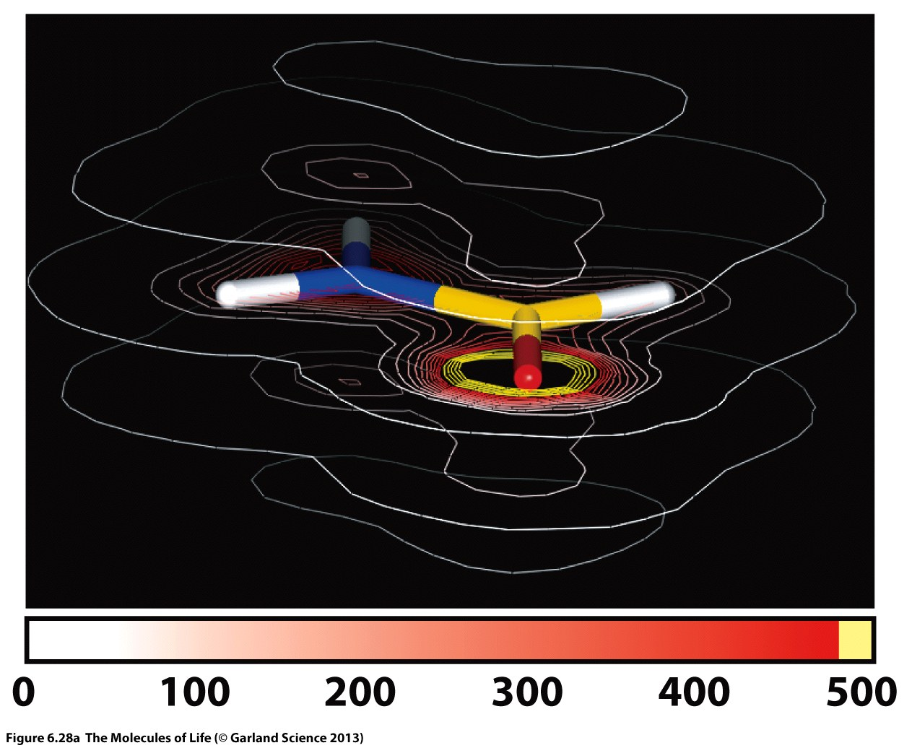
Electrostatics
In bonds involving heteroatoms, electrons are not equally distributed around the participating atoms but have a higher density at the more electronegative atom.
This results in a polarization of the bond which to the outside world represents a dipole.
Electron densities and partial charges can be computed with quantum chemical methods

Slide 8
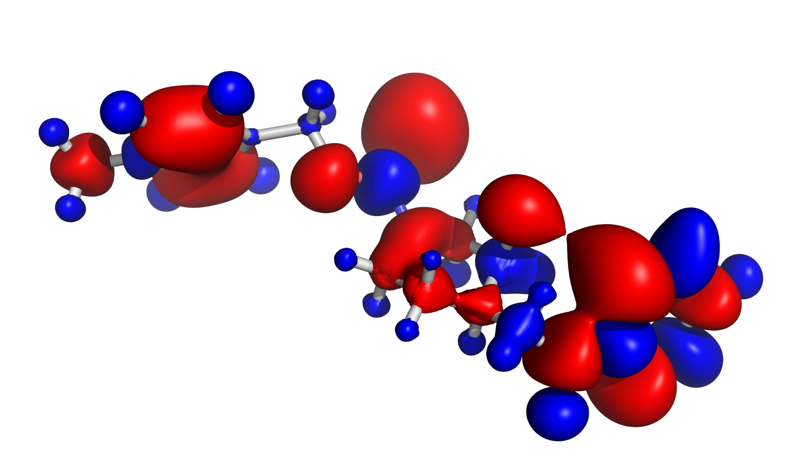

Slide 9
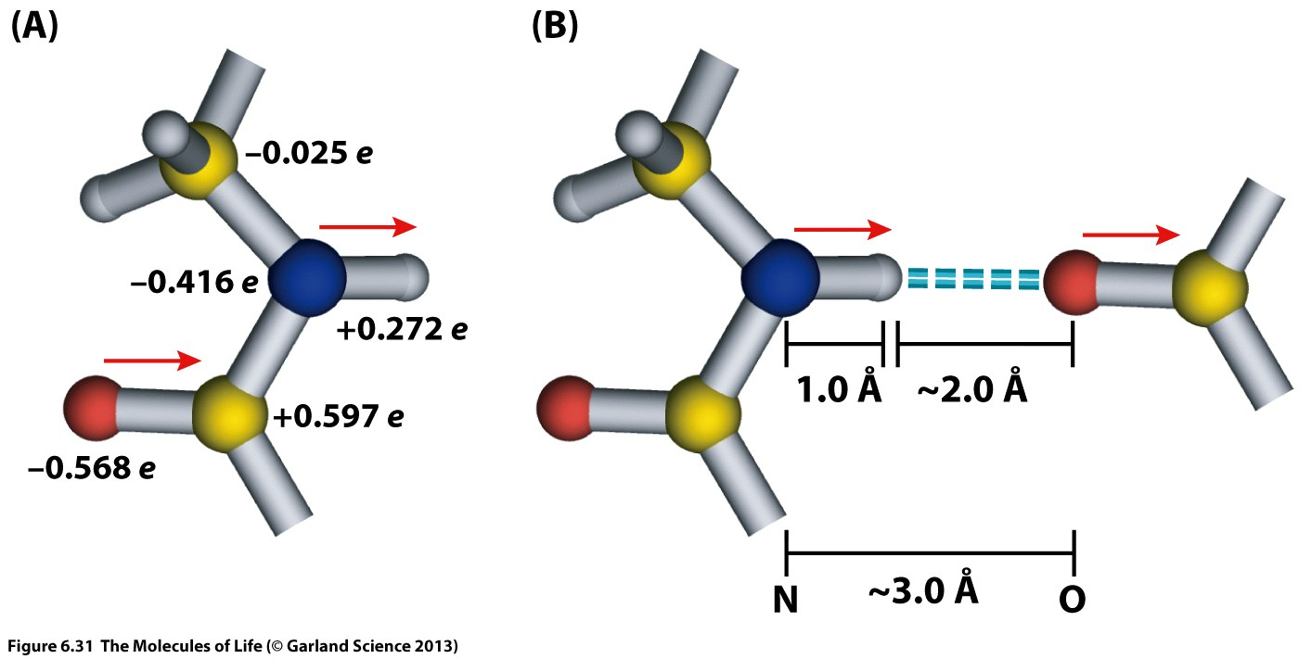
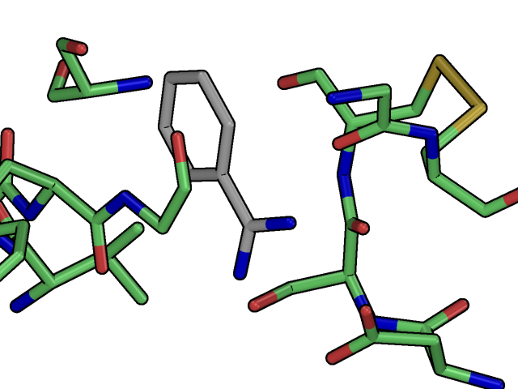
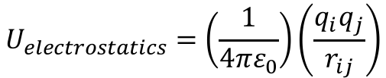
$$U_{electrostatics}=\left(\frac{1}{4πε_{0}}\right)\left(\frac{q_{i}q_{j}}{r_{ij}}\right)$$

Slide 10
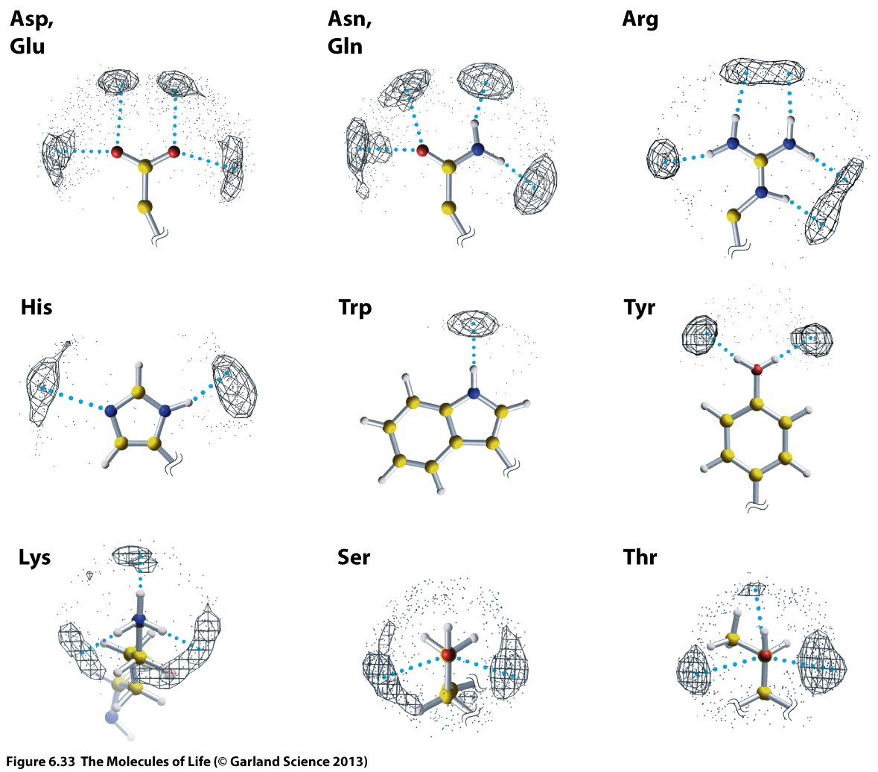
The energy of hydrogen bonds is orientation dependent.

Slide 11
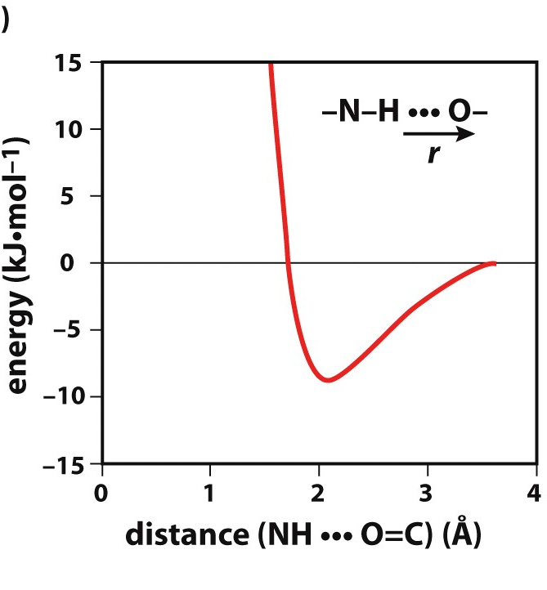
Vacuum energies of hydrogen bonds are 10-20 kJ/mol
The strength of a hydrogen bond depends on the local dielectric ε
In water ε =80, which denotes strong shielding of electrostatic interaction
In a protein environment the local dielectric can vary substantially which means hydrogen bonds can have very different strengths
The strongest hydrogen bonds are those where the hydrogen bond is surrounded by hydrophobic residues

Slide 12
Consequences for Ligand Optimization
Geometric fine tuning of hydrogen bonds
Search for polar interactions in hydrophobic environments

Slide 13
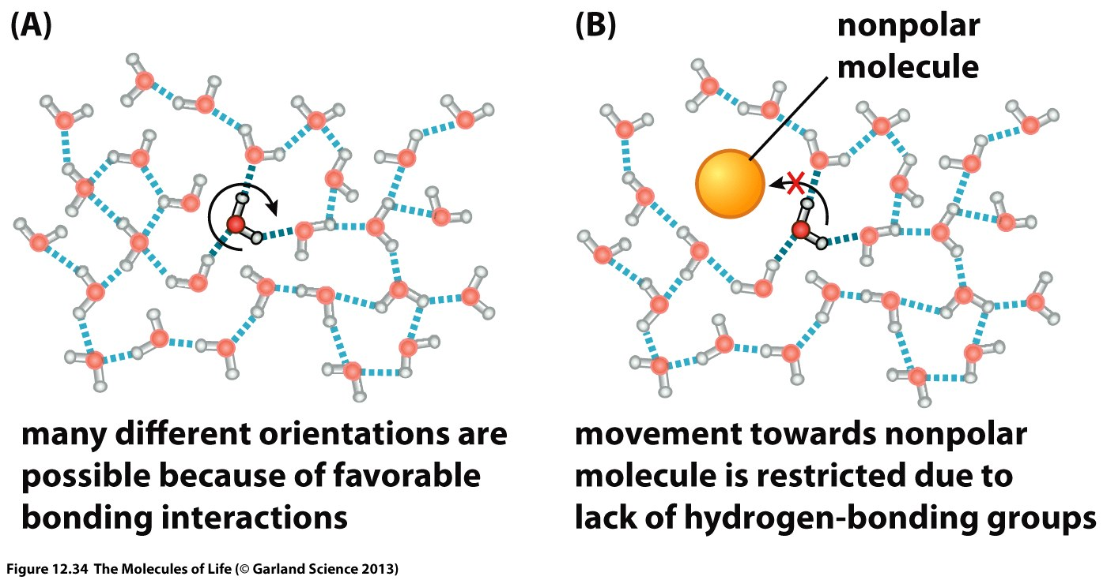
The Role of Water
Protein surfaces have polar and non-polar regions. In non-polar regions, water molecular have less options to form hydrogen bonds

Slide 14
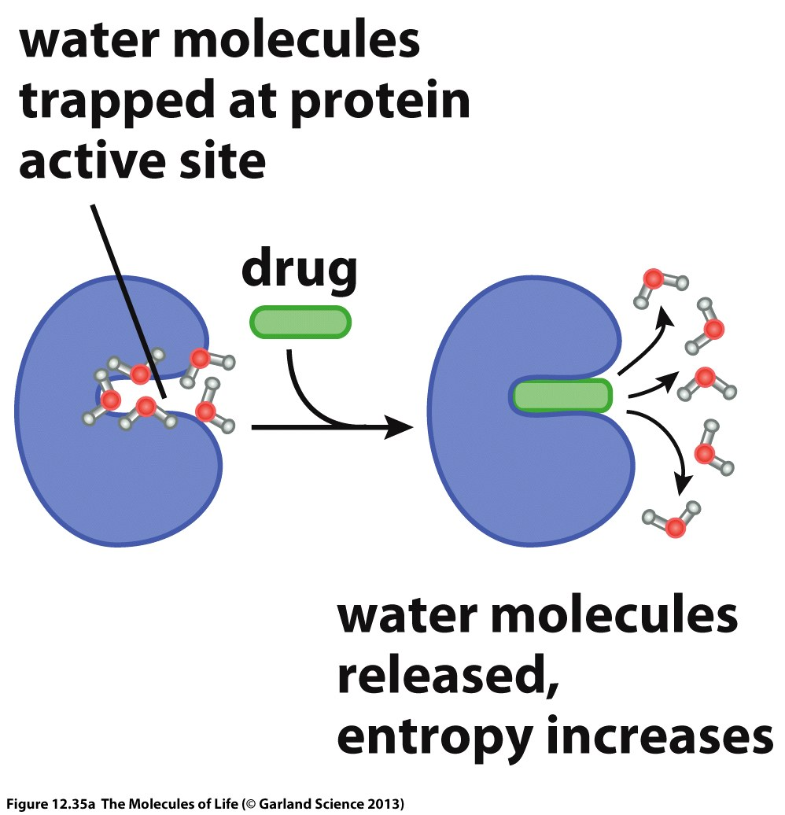
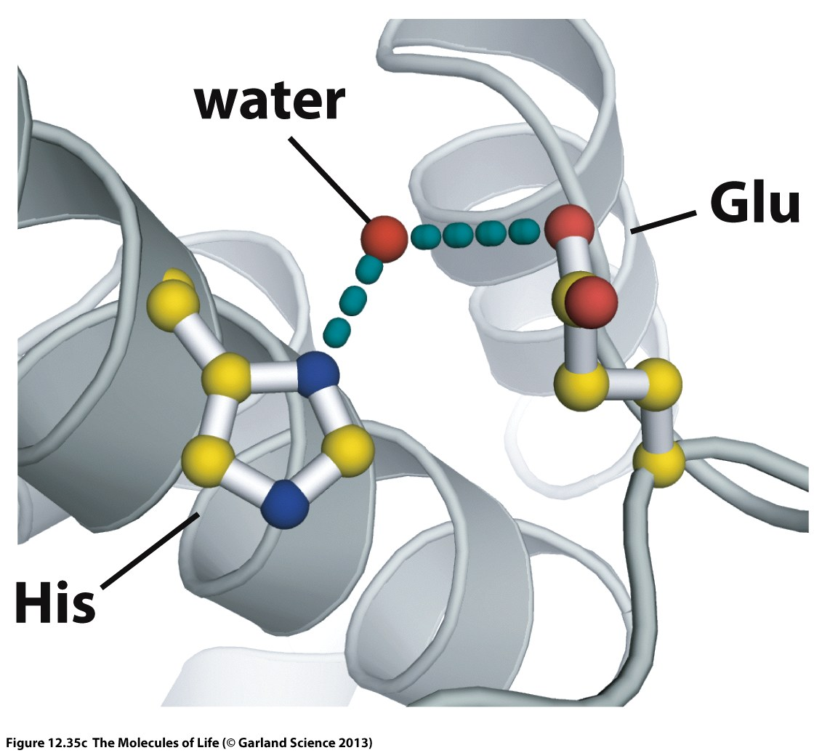
Enforced orientation reduces entropy
Releasing a water molecule from a protein binding site with and equally strong interaction (enthalpy) results in a entropic gain.
Release of water molecules out of hydrophobic environments increases entropy, but also replacement of tightly bound water molecules involved in polar interactions can be beneficial.

Slide 15
Consequences for Ligand Optimization
Fill hydrophobic cavities with non-polar groups
Replace tightly bound water molecules with polar groups

Slide 16
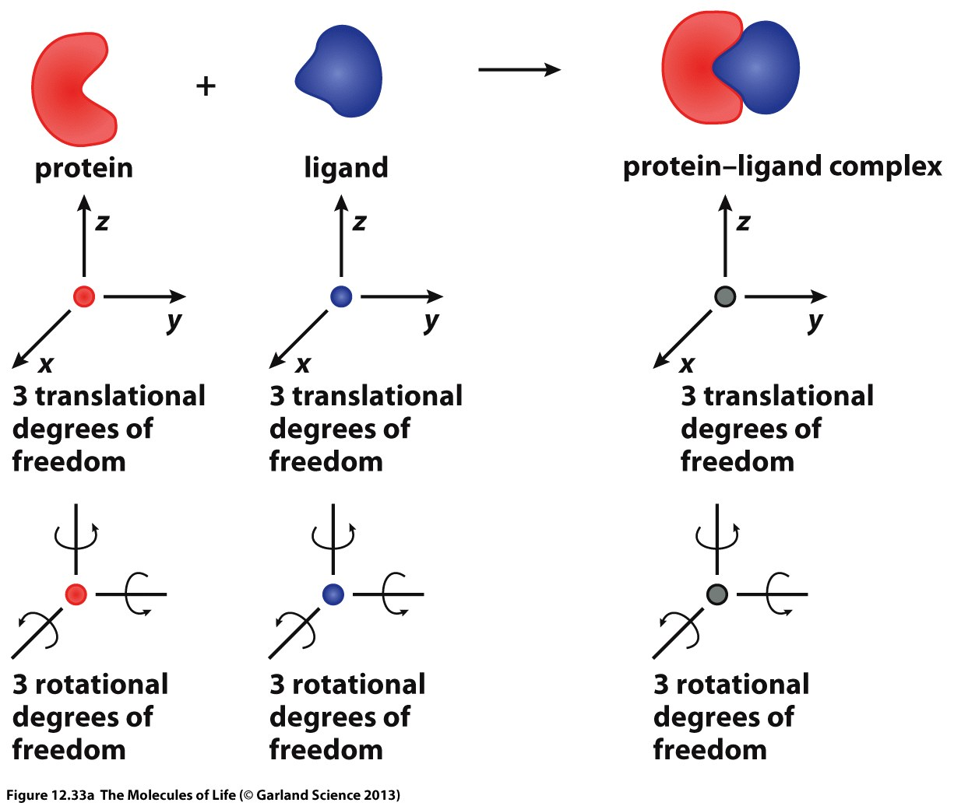
Complex formation is always coupled to a reduction of translational and rotational degrees of freedom. Hence, it is entropically disfavored.

Slide 17
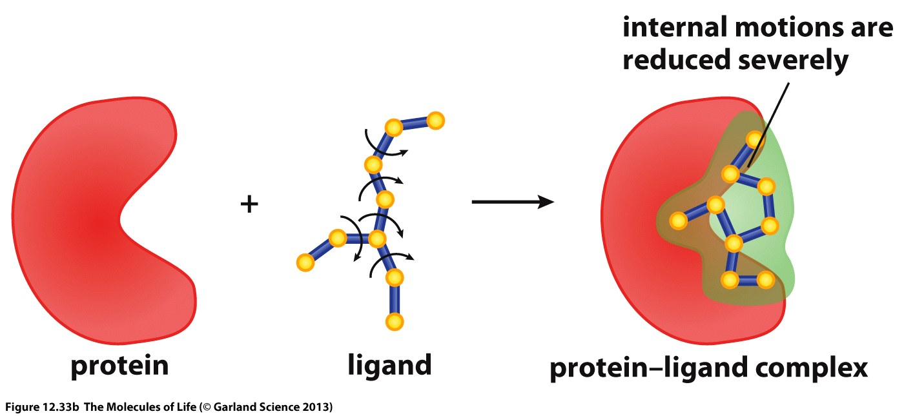
Binding of a ligand to a protein usually requires a specific conformation of the ligand, the so-called bioactive conformation.
This is a restriction of the available conformational space which is entropically disfavored.

Slide 18
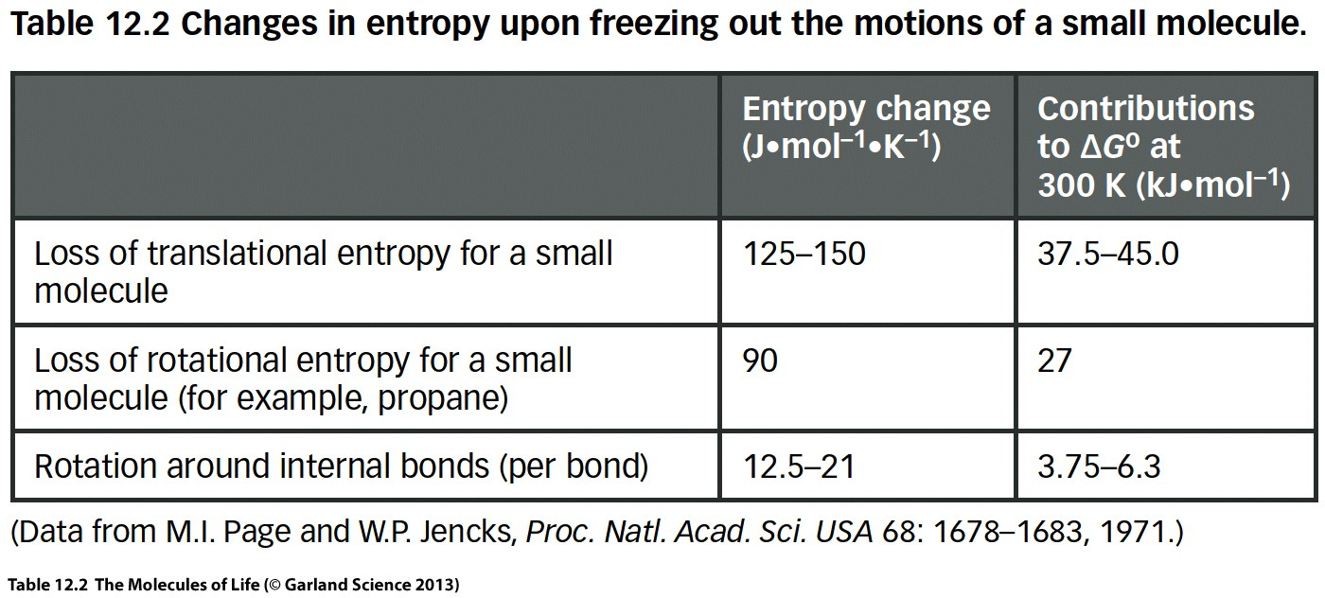

Slide 19
Consequences for Ligand Optimization
Pre-organization of the bound conformation reduces entropy loss upon binding
Find ligand modifications which reduce conformational flexibility

Slide 20
Protein conformational flexibility
Proteins exist in an equilibrium of conformational states
Some of these states will have the correct geometric arrangement to form favorable interactions with a ligand, others not.
Free Energy
Conformational Coordinate

Slide 21
In most cases ligands bind to the protein conformation which represents the global minimum of its free energy landscape.
The binding event stabilizes this conformation even more and the protein cannot change its conformation without releasing the ligand first.
A
A+Ligand
Free Energy
B
A
Conformational Coordinate

Slide 22
B+Ligand
Ligands may also bind to conformational states of the protein which do not represent the global minimum.
In this case binding of the ligand in addition has to compensate for the free energy difference between the global minimum and the conformation to which the ligand binds.
A
B
Free Energy
B
A
Conformational Coordinate

Slide 23
P* + L
ΔG₁
Free Energy
ΔG₂
P + L
ΔG_{bind} = ΔG₁-ΔG₂
P*L

Slide 24
Binding of a ligand usually reduces conformational flexibility of the protein which results in an entropic burden
If the ligand binds to a protein conformation which is not the global minimum of the free energy landscape, the binding free energy must compensate for the energy difference
The phenomenon that ligands can bind to specific protein conformations is called conformational selection.

Slide 25
Why is binding to specific conformations important?
Remember that, e.g. phosphorylation modifies the free energy landscape such that the protein switches to a different conformational state (e.g. from inactive to active).
Active conformation
Free Energy
Inactive conformation
Conformational coordinate

Slide 26
Active conformation
Free Energy
Inactive conformation
Conformational coordinate
Ligand binding can stabilize proteins in inactive/active states such that their normal activation mechanism does not result in the desired conformational change anymore.
This is the basis for allosteric modulation. A principle at which inhibitors do not compete for the binding site of an endogenous ligand but bind to a remote (allosteric) site and thereby alter the protein’s preference for certain conformational states.

Slide 27
Summary:
Interactions between ligands and proteins are formed by van-der-Waals interactions, dipole-dipole interaction, hydrogen bonds and Coulomb interactions
Formation of a complex between two molecules is always entropically disfavored
Release of water molecules from hydrophobic surfaces is a large entropic driving force for protein/ligand binding
Also release of stably bound water molecules involved in hydrogen bonds with the protein are entropically favored
The conformational flexibility of both the protein and the ligand is usually reduced upon binding resulting in an entropic burden
Ligands can bind to different conformational states of the protein and cause a shift in the relative population of these states. This is called conformational selection.

Slide 28
In a drug design project it is of course desirable to be able to predict whether a ligand will bind to a protein or not.
In order to compute the free energy of binding, all interactions must be accurately computed as well as all conformational states of the protein and the ligand, and changes of these states must be taken into account. In addition water molecules must be explicitly considered.
Since entropy and thus free energy is an ensemble property it is by definition not possible to compute it based on the information of a single static structure, which is usually what you have from Xray crystallography.
Hence computation of the free energy of binding is a substantial challenge

Slide 29
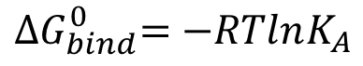
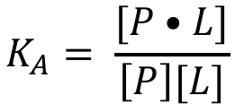
Thermodynamics of Binding
Binding of a ligand to a protein can be described as an equilibrium process:
P + L
P•L
P: Protein, L: Ligand
We can consequently define the association constant:
$$K_{A}= \frac{[P•L]}{\left[P\right][L]}$$
K_{A}: Association constant
Which relates to the free energy of binding ${∆G}_{bind}^{0}$
$${∆G}_{bind}^{0}=−RTlnK_{A}$$

Slide 30
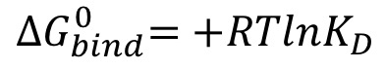
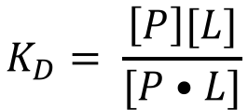
To describe the strength of binding we usually look at the dissociation:
P•L
P + L
With the dissociation constant K_{D}
$$K_{D}= \frac{\left[P\right][L]}{[P•L]}$$
(1)
The free energy of binding then writes:
$${∆G}_{bind}^{0}=+RTlnK_{D}$$

Slide 31
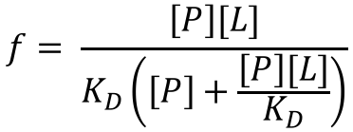
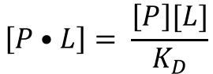
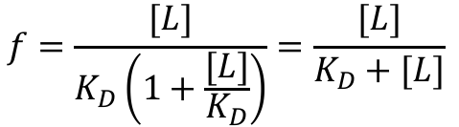
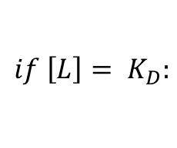
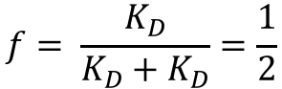
The fraction of protein bound to ligand is:
$$f=\frac{concentration of protein with ligand bound}{total protein concentration}=\frac{[P•L]}{\left[P\right]+[P•L]}$$
(2)
Rewriting equation (1) yields:
$$\left[P•L\right]= \frac{\left[P\right][L]}{K_{D}}$$
(3)
If the concentration of the ligand equals K_{D} we get:
$$if \left[L\right]= K_{D}:$$
With (3) combined with (2) the fraction bound writes:
$$f= \frac{K_{D}}{K_{D}+K_{D}}=\frac{1}{2}$$
$$f= \frac{\left[P\right][L]}{K_{D}\left(\left[P\right]+\frac{\left[P\right][L]}{K_{D}}\right)}$$
K_{D} is the concentration of the ligand at which half of the protein is bound.
Rearranged we arrive at:
$$f=\frac{[L]}{K_{D}\left(1+\frac{[L]}{K_{D}}\right)}=\frac{[L]}{K_{D}+[L]}$$
(4)

Slide 32
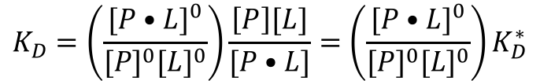
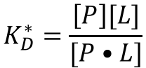
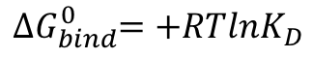
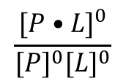
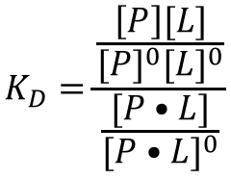
To get everything correct: K_{D} cannot be a concentration but has to be dimensionless.
$${∆G}_{bind}^{0}=+RTlnK_{D}$$
In the correct formulation concentrations are normalized by standard concentrations:
$$K_{D}=\frac{\frac{\left[P\right][L]}{{[P]}^{0}{[L]}^{0}}}{\frac{[P•L]}{{[P•L]}^{0}}}$$
$$\frac{{[P•L]}^{0}}{{[P]}^{0}{[L]}^{0}}$$
The expression
Which can be rewritten as follows:
has the numerical value of 1 but its units cancel those of K_{D}* such that K_{D} becomes dimensionless.
In practice K_{D}s are usually reported with units (molar) since they are always related to concentrations.
$$K_{D}=\left(\frac{{[P•L]}^{0}}{{[P]}^{0}{[L]}^{0}}\right)\frac{\left[P\right][L]}{[P•L]}=\left(\frac{{[P•L]}^{0}}{{[P]}^{0}{[L]}^{0}}\right)K_{D}^{∗}$$
with
$$K_{D}^{∗}=\frac{\left[P\right][L]}{[P•L]}$$

Slide 33
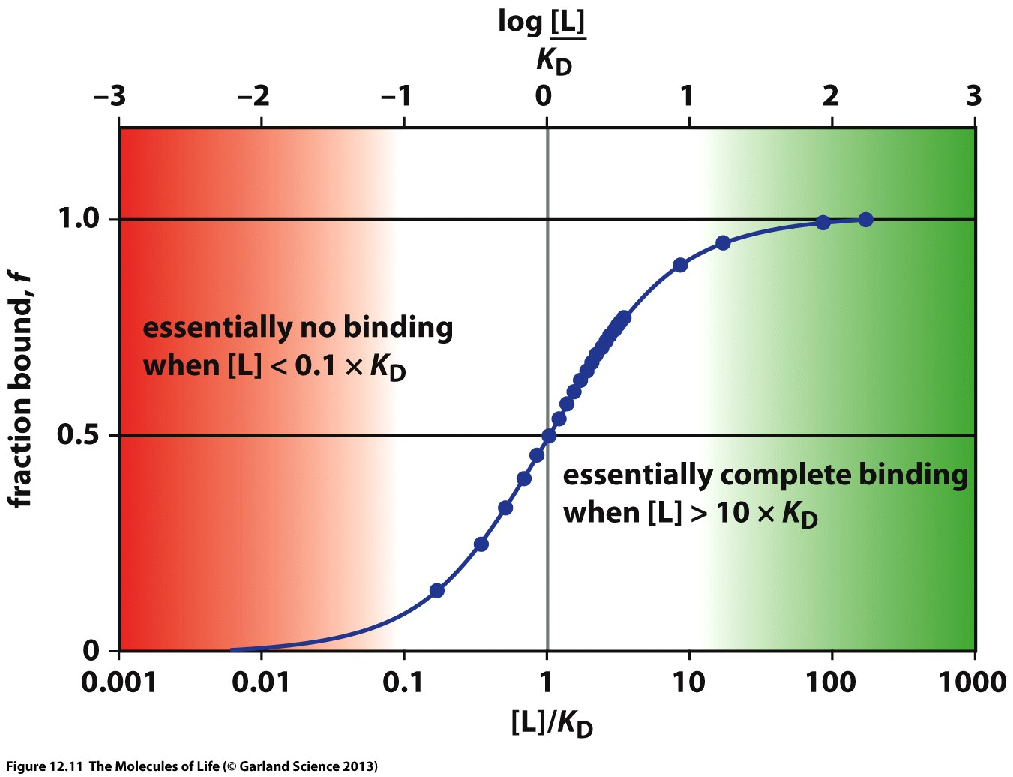
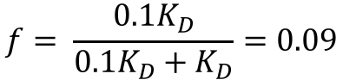
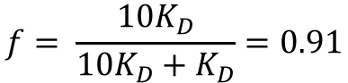
Using equation (4) we can calculate the fraction of protein which is bound at a given concentration of ligand.
$$f= \frac{{10K}_{D}}{{10K}_{D}+K_{D}}=0.91$$
$$f= \frac{{0.1K}_{D}}{{0.1K}_{D}+K_{D}}=0.09$$

Slide 34
How to measure K_{D}?

Slide 35
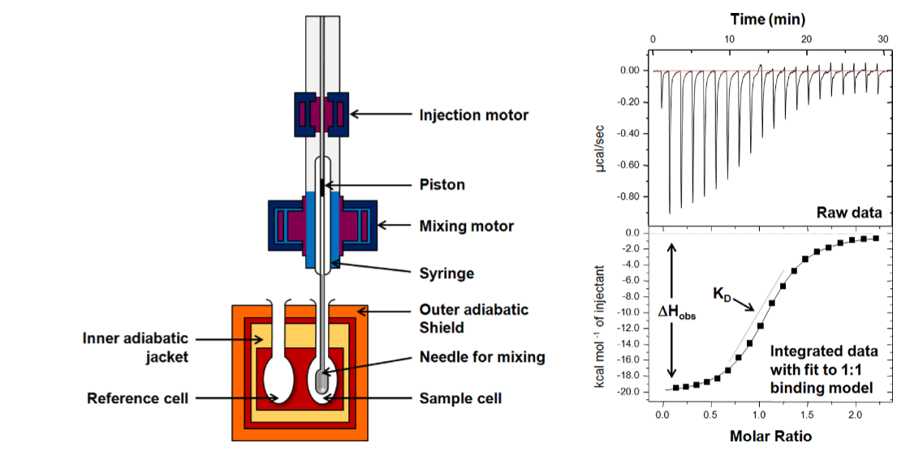
Isothermal titration calorimetry (ITC)

Slide 36
In an ITC experiment both K_{D} and ΔH can be determined in a single experiment.
ΔG is obtained from the relation: ΔG = RT ln K_{D}
The entropic contribution to the free energy of binding can be calculated TΔS = ΔH - ΔG

Slide 37
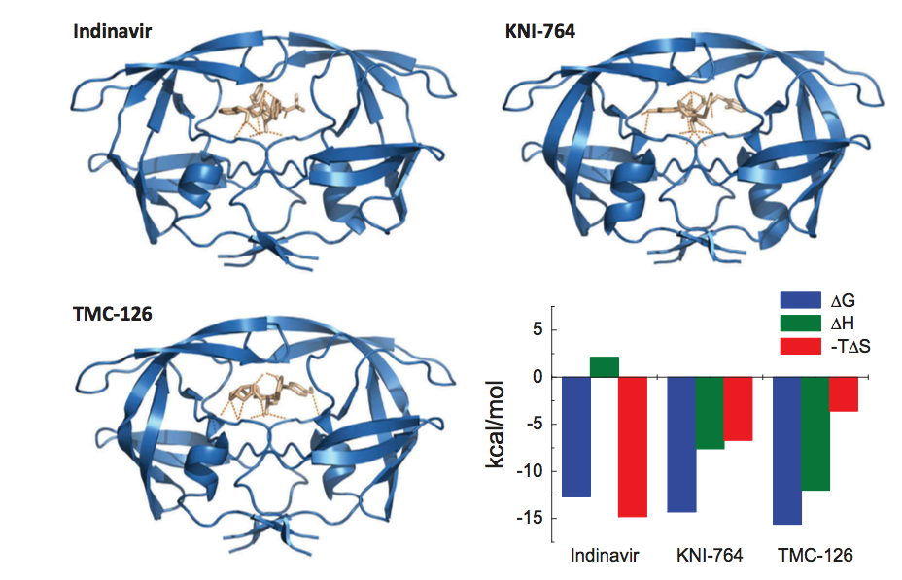

Slide 38
The entropic contribution to the free energy of binding coming from the release of water molecules from hydrophobic surfaces is a strong driver for affinity.
Hydrophobic pocket
As long as there are no clashes with protein surfaces it is not important which specific type of hydrophobic group is filling the pocket.
Hydrophobic molecules therefore have the tendency to bind to all kinds of hydrophobic cavities and binding sites
This non-specific binding can lead to off-target activity and lead to side-effects.

Slide 39
Polar groups, in particular hydrogen bonds, form excellent interactions with water molecules. There is no driving force which pulls them into a binding site
In addition, hydrogen bonds have a very strong directional component. To form a strong hydrogen bond the geometric orientation is very important.
The interaction energy drops sharply if the geometry deviates from the optional distance (~0.2 nm) or the optimal angle (180 deg).
It is much more difficult to find favorable polar interactions than filling hydrophobic pockets.

Slide 40
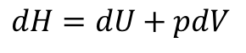
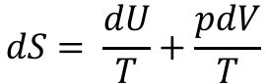
Enthalpic optimization?
$$dH=dU+pdV$$
$$dS= \frac{dU}{T}+\frac{pdV}{T}$$
A change of the ligand results in a change of U. A change in U always affects both, enthalpy and entropy.
Thermodynamic ”signatures” of ligands can therefore be very difficult to interpret.

Slide 41
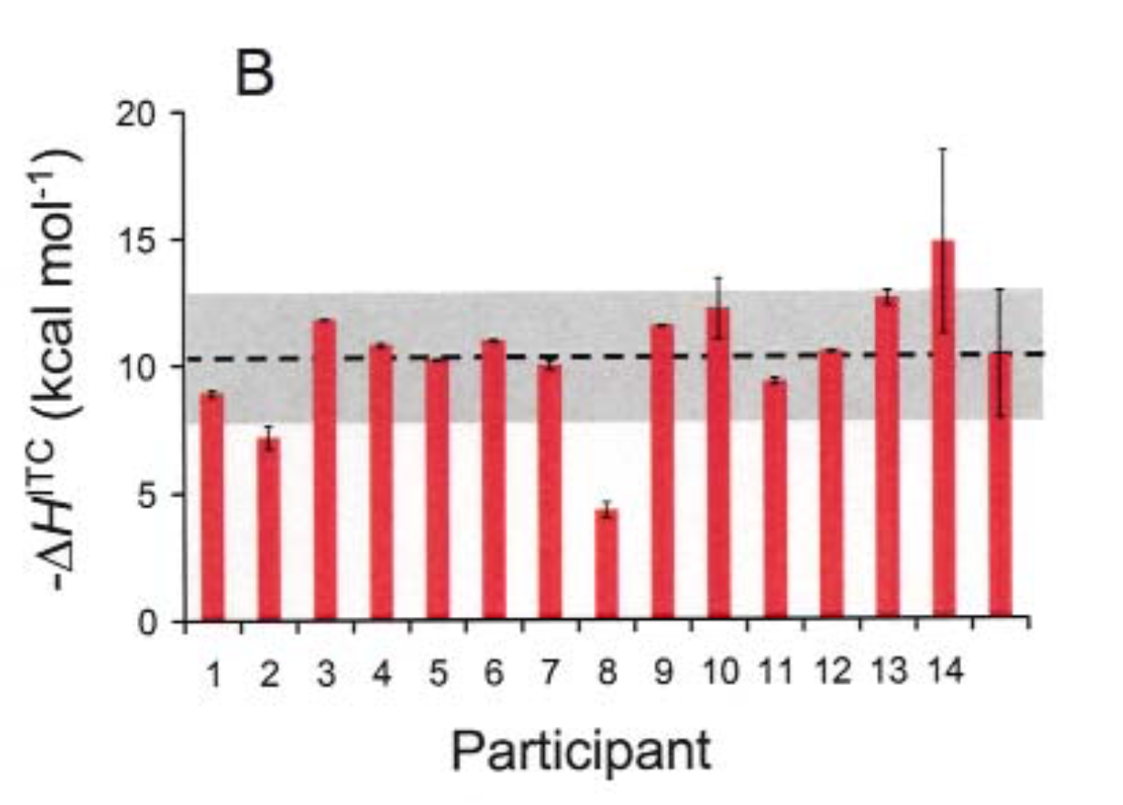
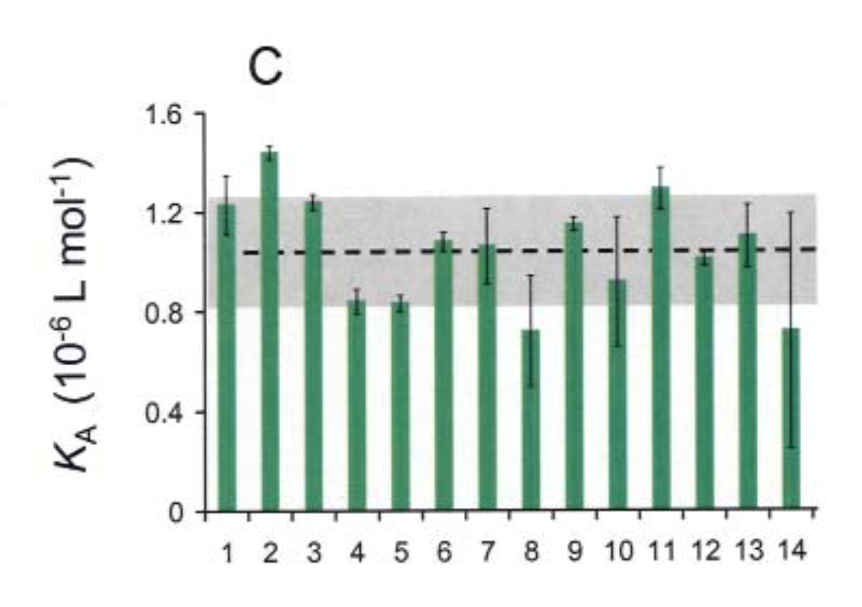
Laboratory variability of ITC measurements
ΔG can be measured much more accurately than ΔH. ΔS is computed from the difference of both. Errors in ΔH therefore automatically lead to an error of the same magnitude in ΔS.
Although heavily advertised, thermodynamic measurements are not routinely used in industrial drug discovery. ITC measurements require very high protein quality, large amounts of protein and are too labor intensive to allow substantial throughput.

Slide 42
Anyway…. Hydrophobicity matters!
Hydrophobicity is an important molecule parameter since high lipophilicity is generally associated with unspecific binding and other undesired effects.
The most commonly used measure for hydrophobicity is the octanol/water partition coefficient log P. It is always measured with the molecule in its neutralized form, which means at different pH values.
A similar measure is the distribution coefficient at a given pH, e.g. log D_{7.4}, the distribution coefficient at pH 7.4. This property is dependent on pKa value(s) of a molecule.
Log P can be computed with reasonable accuracy. The computed log P is referred to as clogP.

Slide 43
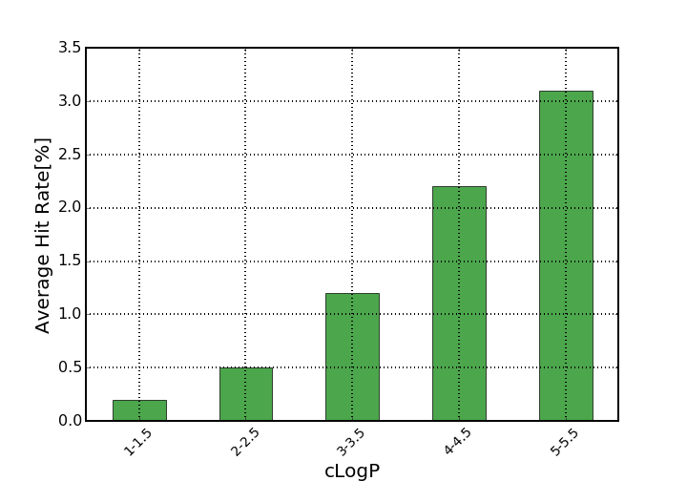
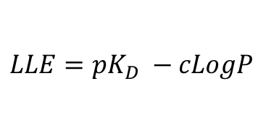
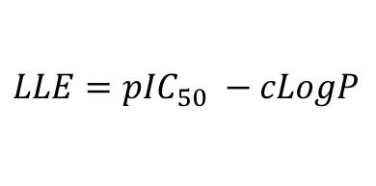
Affinity vs. Hydrophobicity
Proteins are always more lipophilic than water. Hence, lipophilic compounds have a higher probability to be found as hits in screenings.
However, affinity which is driven by hydrophobicity, is non-specific.
Affinity/Activity values are often corrected for hydrophobicity to allow for an estimate of specific binding.
$$LLE=pK_{D} −cLogP$$
$$LLE=p{IC}_{50} −cLogP$$
LLE: Ligand lipophilic efficiency

Slide 44
How to measure protein function?

Slide 45
Although the strength of binding (K_{D}) is sometimes measured in drug discovery projects, it is in most cases not the quantity of interest. We usually want to know how the function of a protein is influenced.
Remember last lecture when we discussed GPCRs that ligand binding can have quite different consequences: Agonism, anatagonism, partial agonism, or just binding without affecting function.
100
Agonist
75
Partial agonist
50
25
Response (%)
0
Neutral antagonist
-25
Inverse antagonist
-50
10⁻¹⁰
10⁻⁹
10⁻⁸
10⁻⁷
10⁻⁶
[Drug]

Slide 46
In most drug discovery projects functional assays are used to determine the activity of a test molecule.
An assay is an experimental setup which allows to monitor the function of a protein in the presence of different concentrations of ligand. It should give a quantitative and reproducible output to allow for assessment of the potency of different molecules.
The term functional means that not binding is observed but the readout is related to the protein’s role in physiology.

Slide 47
Fluorescence Resonance Energy Transfer (FRET)
A fluorescent molecule absorbs radiation at specific wavelength
The energy is transferred to nearby acceptor molecule which emits radiation at a different wavelength
The efficacy of this transfer is distance dependent, hence by measuring the intensity of the acceptor wavelength, the distance between acceptor and donor can be measured
490 nm
FRET
340 nm
DABCYL
HIV Protease
EDANS
340 nm
490 nm
HIV Protease cleaves peptides. If donor and acceptor molecules are fused to the peptide, the activity of the enzyme can be measured by measuring the FRET signal.

Slide 48
AlphaScreen
Phthalocyanine produces singlet oxygen upon radiation with light with a specific wavelength (680nm).
Thioxene derivatives emit light at 520-620 nm in the presence of singlet oxygen
The signal intensity depends on the spatial proximity of donor and acceptor molecule
Phthalocyanine
Thioxene derivative
680 nm
¹O₂
PO₄
D
A
Bio
Kinase
680 nm
Bio
¹O₂
SA
D
A
680 nm
¹O₂
PO₄
D
A
Bio

Slide 49
Measuring GPCR signaling in cells
Ca²⁺ concentration in the cytoplasm is low. Most of the Ca²⁺ is stored in the endoplasmatic reticulum
GPCR signaling via the IP3 cascade results in release of Ca²⁺ from the ER.
Several specialized dyes have been developed which are fluorescent in the presence of Ca²⁺
This assay principle is often used to measure GPCR signaling.
Fluo-4
IP₃ Cascade
Endoplasmic reticulum Ca⁺² release
409 nm
Dye
Fluo-3

Slide 50
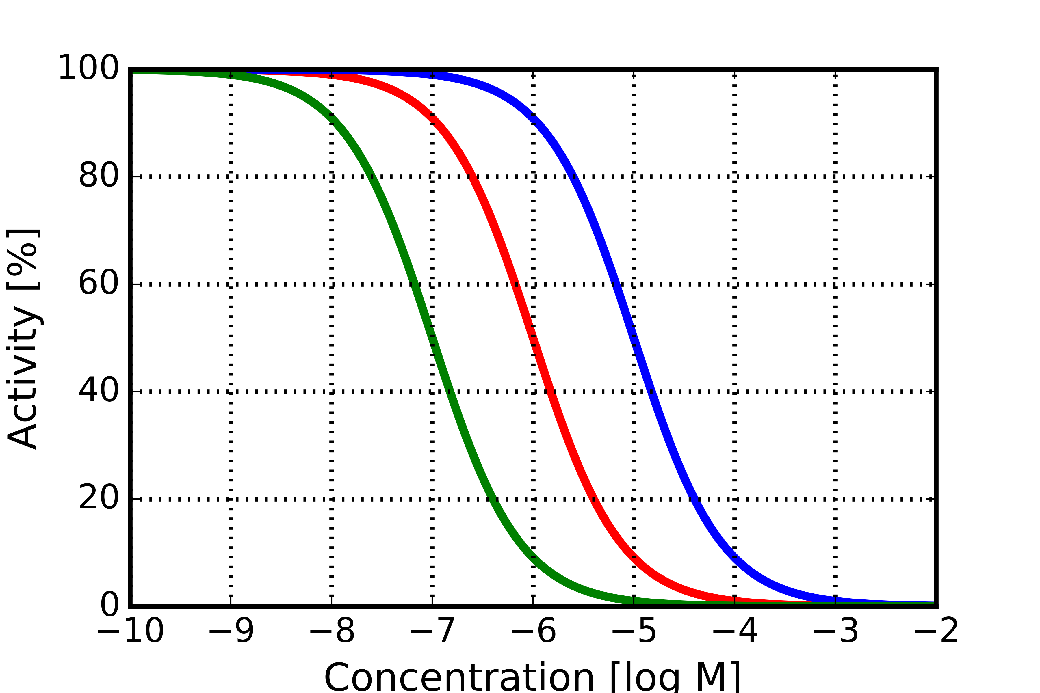
To assess the activity of ligands, the concentration is plotted against the activity (Dose-Resonse-Curve)
The concentration at which activity has dropped to 50 % is called IC50.
Inhibitor 1: IC50 = 100 nM
Inhibitor 2: IC50 = 1 μM
Inhibitor 3: IC50 = 10 μM

Slide 51
Inhibitors do not always reach 100% inhibition
The EC50 is the concentration at which a compound reaches 50% of its maximal effect.
Inhibitor 1: IC50 = EC50 = 100 nM, Max Inhibition = 100 %
Inhibitor 2: IC50 = 3 μM, EC50 = 1 μM, Max Inhibition = 80%
Inhibitor 3: IC50 = 50 μM, EC50 = 10 μM, Max Inhibition = 70%

Slide 52
For agonists it is important to know the maximum activation a compound reaches (Emax) and at which concentration it is reached (EC50).
Here the green agonist reaches a 2-fold activation already at 10nM but its maximum activation does not exceed 300%.
The blue agonist is completely inactive at 10nM but reaches >500% activation at higher doses
Which profile is desirable depends on the therapeutic setting. Sometimes partial inhibition or agonism is preferred over full inhibition/agonism.
Agonist 1: EC50 = 10 nM, Max Activation = 300 %
Agonist 2: EC50 = 1 μM, Max Activation = 450%
Agonist 3: EC50 = 10 μM, Max Activation = 550%

Slide 53
The K_{D} is a thermodynamic property determined by the free energy of binding. It depends on buffer conditions (salts, pH) but not on the presence or absence of other ligands
Functional readouts like IC50 and EC50 describe the activity of a protein and therefore are dependent on the presence of other ligands (competition).
+
+
K_{D} of Inhibitor is independent of the K_{D} of ATP
Inhibitor
ATP
Kinase
+
+
Active Kinase
Inhibited Kinase

Slide 54
+
+
Inhibitor
ATP
Kinase
+
+
Active Kinase
Inhibited Kinase
If the concentration of ATP (in cells ~1mM) is much higher than the concentration of an inhibitor, effective inhibition becomes more difficult since the IC50 shifts.

Slide 55
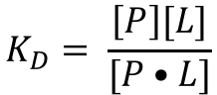
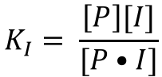
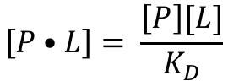
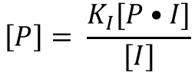


The activity of a protein is proportional to the concentration of protein bound to ligand:
$$activity=C[P•L]$$
To inhibit the protein with an inhibitor I, the ligand L has to be competitively replaced:
$$P•L+I⇌P+L+I⇌L+P•I$$
K_{D} and K_{I} can be expressed as:
$$K_{D}= \frac{\left[P\right][L]}{[P•L]}$$
(5)
and
$$K_{I}= \frac{\left[P\right][I]}{[P•I]}$$
(6)
Rewriting (5) as
$$\left[P•L\right]= \frac{\left[P\right][L]}{K_{D}}$$
(7)
and (6) as
$$\left[P\right]= \frac{K_{I}[P•I]}{[I]}$$
(8)
and merging (8) into (7) yields:
$$\left[P•L\right]= \left(\frac{K_{I}[P•I]}{[I]}\right)\left(\frac{[L]}{K_{D}}\right)$$
(9)

Slide 56








Total protein concentration is given by:
$${[P]}_{total}=\left[P\right]+\left[P•I\right]+[P•L]$$
$$\left[\left(\frac{[I]}{K_{I}}\right)+1+\left(\frac{[L]}{K_{D}}\right)\right]\left[P•L\right]= \frac{[L]}{K_{D}}{[P]}_{total}$$
Which rewrites as:
Rearranged we get the expression for [P•L]:
$${\left[P•I\right]= [P]}_{total}−\left[P\right]−[P•L]$$
(10)
Substituting [P•I] from (10) and inserting into (9) we get:
$$\left[P•L\right]=({\left[P\right]}_{total})\frac{[L]}{K_{D}\left(1+\frac{[I]}{K_{I}}\right)+[L]}$$
(11)
$$\left[P•L\right]= \left(\frac{K_{I}}{[I]}\right)\left(\frac{[L]}{K_{D}}\right){([P]}_{total}−\left[P\right]−[P•L])$$
We denote:
$$α=\left(1+\frac{[I]}{K_{I}}\right)$$
and rewrite (11) as:
Rearranging terms, we get:
$$\left[P•L\right]=({\left[P\right]}_{total})\frac{[L]}{{αK}_{D}+[L]}$$
(12)
$$\left(\frac{[I]}{K_{I}}\right)\left[P•L\right]+\left(\frac{[L]}{K_{D}}\right)\left[P•L\right]+ \frac{\left[L\right][P]}{K_{D}}=\frac{[L]}{K_{D}}{[P]}_{total}$$
The last term on the the left-hand side is equal to [P•L].

Slide 57




If no inhibitor would be present, the concentration of the protein bound to the ligand would be given by the product of the total protein concentration and the fractional saturation f:
$$\left[P•L\right]=({\left[P\right]}_{total})(f)$$
where
$$f=\frac{[L]}{K_{D}+[L]}$$
(4)
With inhibitor present the expression changes to:
$$\left[P•L\right]=({\left[P\right]}_{total})\frac{[L]}{{αK}_{D}+[L]}$$
(12)
α is always greater than 1 so the effect of the inhibitor is to scale the value of K_{D} so that the apparent strength of interaction between the ligand and the protein is weakened.
with
$$α=\left(1+\frac{[I]}{K_{I}}\right)$$

Slide 58



With (12) we can express the activity as:
$$activity=C\left[P•L\right]=(C{\left[P\right]}_{total})\left(\frac{[L]}{{αK}_{D}+[L]}\right)$$
The ratio of the activity in the absence of the inhibitor to that when the inhibitor is present is given by:
$$\frac{{(activity)}_{inhibitor}}{{(activity)}_{no inhibitor}}=\frac{(C{\left[P\right]}_{total})\left(\frac{[L]}{{αK}_{D}+[L]}\right)}{(C{\left[P\right]}_{total})\left(\frac{[L]}{K_{D}+[L]}\right)}=\frac{\left(\frac{[L]}{{αK}_{D}+[L]}\right)}{\left(\frac{[L]}{K_{D}+[L]}\right)}$$
When the concentration of the inhibitor [I] is equal to the value of the IC50, then this ratio is equal to 0.5:
$$\frac{\left(\frac{[L]}{{αK}_{D}+[L]}\right)}{\left(\frac{[L]}{K_{D}+[L]}\right)}=\frac{1}{2}$$
(13)

Slide 59



When the inhibitor concentration is equal to IC50, the scaling parameter α is given by:
$$α=\left(1+\frac{[I]}{K_{I}}\right)$$
Substituting this into (13) , we get:
$$K_{I}={IC}_{50}\left(\frac{K_{D}}{K_{D}+[L]}\right)$$
Rearranging finally yields:
$${IC}_{50}=\frac{K_{I}(K_{D}+\left[L\right])}{K_{D}}$$
(14)
Which relates the IC50, K_{I}, K_{D} and the concentration of the ligand [L]

Slide 60

Putting this into practice:
The ATP concentration inside cells is in the range of 10⁻³M, the K_{D} for kinases and ATP is around 10⁻⁵M. Using these values in (14) yields:
$${IC}_{50}=\frac{K_{I}({10}^{−5}+{10}^{−3})}{{10}^{−5}}\sim K_{I}•100$$
Hence, due to the presence of ATP in high concentrations, the IC50 shifts by two orders of magnitude. For efficient inhibition of a kinase we therefore need a very potent inhibitor or achieve very high inhibitor concentrations within the cell.

